Slide 1
FreeDyn API
stefan.oberpeilsteiner@fh-wels.at

Slide 2
FreeDyn
www.freedyn.at
GUI
Efficient solver
Standard elements like forces, constraints, measures, …
Please have a look into the according slides for more specific information ➔ 01_FreeDyn_Multibodysimulation_en.pptx
© FreeDyn 2020

Slide 3
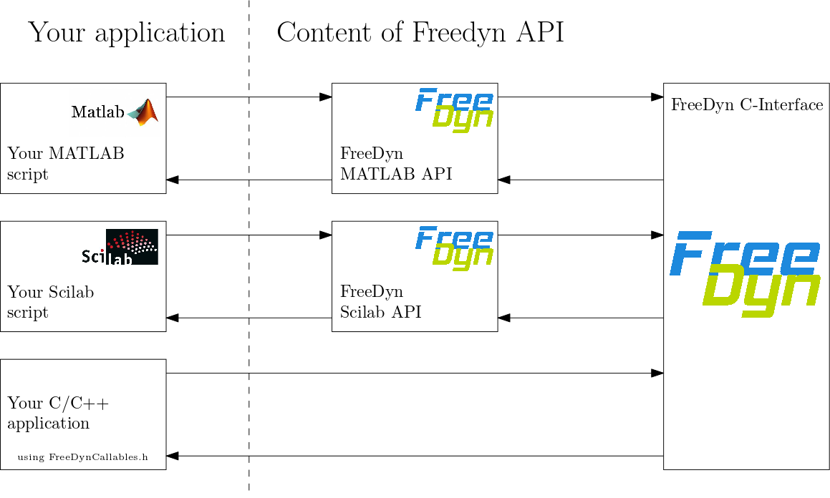
FreeDyn API
Package includes
C-Library with functionality of FreeDyn ➔ for the use in own C/C++ Code
API – Application Programming Interface for
MATLAB API for easy access from MATLAB script no need for use of calllib-functions
Scilab API for easy access from Scilab script no need for use of call-functions
© FreeDyn 2020

Slide 4
FreeDyn API MATLAB/Scilab
Native use of FreeDyn functionality within MATLAB/Scilab scripts
Function overview
Infrastructure
createModel … create a model by providing a .fds – file (FreeDyn inputfile)
deleteModel
getModelInfos … get infos about model (number of generalized coordinates, constraints, measures, parameters)
getMeasureNames ... get labels of measures (as defined in FreeDyn model)
Full system simulation
solveEOM … solve equations of motion (full simulation from start to end time)
Simulation of successive intervals
getInitialConditions … compute initial conditions for accelerations and Lagrange multipliers
solveTimeInterval … start the simulation of a specific time interval (down to one single time step)
modifyParameter … modify parameters, e.g. the amplitude of a force
Retrieve data from FreeDyn
getNumTimeSteps … get number of time steps stored for current solution
getStatesAtTIme … get values of all states at time index (generalized coordinates, velocities, accelerations, Lagrange multipliers)
getMeasuresAtTime … get values of all measures at time index
© FreeDyn 2020

Slide 5
FreeDyn API C/C++ Applications
Make use of FreeDyn functionality by linking FDCI.dll (FreeDyn C-Interface DLL) to your own C/C++ application
FDCI.dll is designed for runtime linking ➔ Interface functions are defined in FreeDynCallables.h
External control of MBS Model
Modification of parameters
Control of time integration
Solve entire time period from initial states to end time
Solve one time interval and restart from previous one
Retrieve data from FreeDyn
States, Velocities, Measures
Jacobi matrices (entire, or only submatrices)
➔ May be used for implementing/testing new solvers/methods
© FreeDyn 2020

Slide 6
FreeDyn API Example (1) – Driver Model XBug
Use FreeDyn API for MATLAB
Model created with FreeDyn GUI stored as .fds-file
MATLAB script
Compute initial conditions
Execute loop:
Evaluate measures (vehicle position, heading, velocities)
Determine control input for steering and driving torque in order to stay on predefined track ➔ apply by “modifyParameter”
© FreeDyn 2019

Slide 7
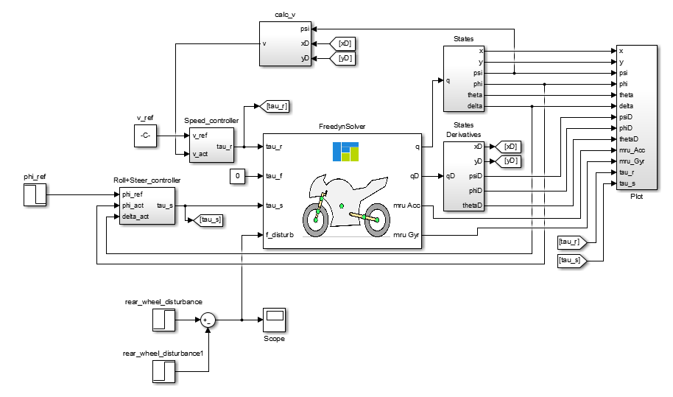
FreeDyn API Example (2) – Driver Model Motorcycle
Use FreeDyn FDCI.dll in Simulink block
Model created with FreeDyn GUI stored as .fds-file
Model specs:
Magic tire formulation (MF6.1)
9 rigid bodies, 43 constraints
11 degrees of freedom
How to create Simulink block out of FreeDyn model?
Copy our template in your model directory
Execute MATLAB Script, here we go!
➔ Available as demo for download http://www.freedyn.at/download/freedyn-api
© FreeDyn 2019

