Slide 1
Multibody Simulation using FreeDyn
wolfgang.witteveen@fh-wels.at

Slide 2
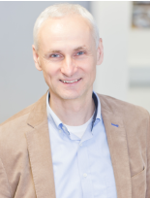
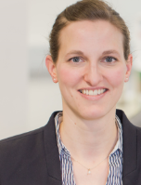
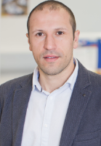
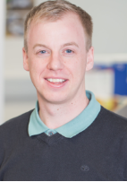
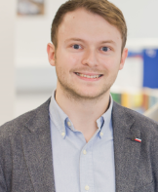
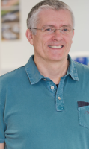
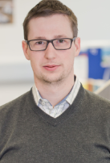
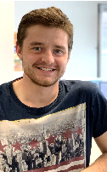
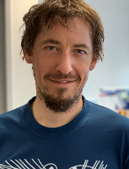
Research Group
multibody dynamics basics
optimization of complex MBS models
FreeDyn development
contact mechanics
model reduction
distributed systems/models
Multibody Simulation
© FreeDyn 2020

Slide 3
FreeDyn
2012 Start of Funded Research Project „MKS 2020“
Several other Sponsored and Third-party Funded Projects
KTM, BMW, BRP-Rotax, ENGEL, ….
Main findings and conclusions
Own state-of-the-art MBS code www.freedyn.at
We know the equations very well http://www.freedyn.at/publications/
© FreeDyn 2020

Slide 4
FreeDyn
Free Download www.freedyn.at
GUI
Pre- and postprocessing
Efficient Solvers
Kinematic
Static
Dynamic
Available as C-Library
More info in respective set of slides
Interface to MATLAB\Simulink (Simulink – block)
Usage in own software (C/C++)
© FreeDyn 2020

Slide 5
FreeDyn
www.freedyn.at
Why?
Build knowledge
Arbitrary research possibilities
Non-standard industrial projects
Subroutines und know-how for Commercial MBS Software too
e.g.: MSC.ADAMS
© FreeDyn 2020

Slide 6
FreeDyn Modelling Elements
Rigid Bodies
Generic and STL import
Flexible Bodies (FFRF)
Constraints
Lock degrees of freedoms between bodies individually (rotation and translation)
Impressed motion
© FreeDyn 2020

Slide 7
FreeDyn Modelling Elements
Generic Force- and Torquevector
Definition using mathematical expression
Depending on time, state, velocity
Special Force Elements
3D guidance (Points is enforced to stay on predefined curve in space)
User-written subroutine
Rigid body contact (Hippmann)
Optional: Pacejka tire
© FreeDyn 2020

Slide 8
FreeDyn Performance
Double Lane Change KTM XBow GT4
31 rigid bodies (=217 DOF)
203 constraint equations
Pacejka (MF 6.1.2)
5.2 sec CPU Time for 6 sec Simulation Time
1e-3 max time step
Laptop (Win10), 32 GB RAM
Processor Intel(R) Core(TM) i7-8650U CPU @ 1.90GHz, 4 core
© FreeDyn 2020

Slide 9
FreeDyn Opportunities
Engineering Services
Introduction of FreeDyn in your Company
Development of Customer-specific Needs
e.g. force elements
Joint Research Projects
Use FreeDyn as Block in MATLAB/Simulink
more infos in respective slides
Superfast Consideration of Contact- and Friction Forces Acting on Flexible Bodies
more infos in respective slides
© FreeDyn 2020

